Slide 1

Addressing Churn in GE’s Healthcare IT Service
A Data Analytic Solution
By Michael Surdek

Slide 2
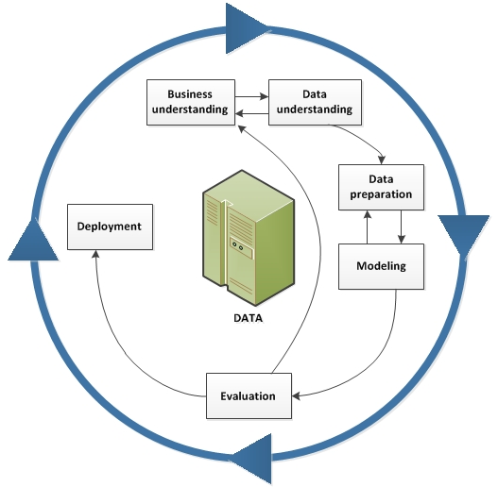
Agenda
CRISP-DM Phases
1. Business Understanding
2. Data Understanding
3. Data Preparation
4. Modeling
5. Evaluation
6. Deployment

Slide 3
Phase 1
Business Understanding
1. The Product
2. The Problem
3. Objective
4. Tools
5. Approach

Slide 4
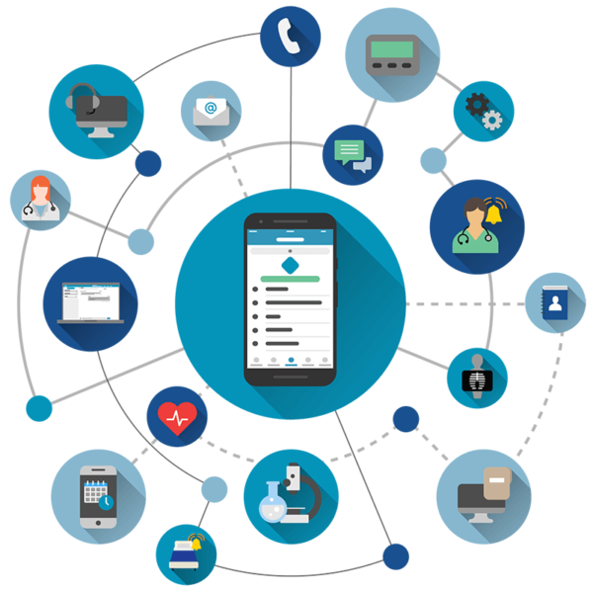
The Product
GE’s Healthcare IT application
- Assists medical professionals in their daily work
Customers are required to use:
- A GE-provided smartphone
- Coverage from their partner SmartAppCellular

Slide 5
The Problem
Recent increase in churn
Customer feedback indicates potential causes:
- Poor cellular coverage
- New vendors competing in the same space

Slide 6
Objective
Use data mining and analytics to understand the causes of churn and predict which customers are likely to churn
Pilot project can reveal whether there are signals in the data that are worth pursuing with further investment

Slide 7
Tools
R → programming language for statistical analysis and predictive modeling
Integration with current CRM platform for customer service & active outreach

Slide 8
Approach
Binary classification
Logistic regression model
Predicts whether or not a customer is likely to churn

Slide 9
Phase 2
Data Understanding
1. Source Data Set
2. ID & Target
3. Personal
4. Usage
5. Subscription
6. Equipment
7. Customer Service

Slide 10
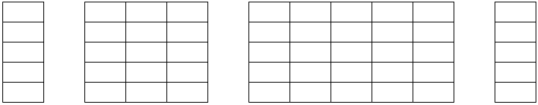
Source Data Set
Derived monthly from data warehouse
After preliminary cleaning and removing redundant variables, the sample data set contains 850 observations of 58 fields
17 Fields
Personal/Demographic
39 Fields
Usage/Subscription/Equipment
Target
Churned?
ID
Notes:
The data set that GE has compiled from their monthly reporting system is well suited for the purposes of building an analytical model to predict customers who are likely to churn. The sample data contains 1000 observations with 84 variables for each subscriber. There are approximately 30 fields that pertain to cellular coverage, equipment, and average usage patterns. The remaining fields include information on each individual such as family makeup, credit rating, occupation, and customer service history. Only 3 fields include categorical values, and the others are numeric, although some of these represent categories and are stored as binary numbers 1 and 0. In fact, 2 of the 3 categorical fields are labels for those binary variables just mentioned. Trial and error in the modeling phase can determine whether it is better to use the labels or the dichotomized values.

Slide 11
ID & Target Data
Unique Identifier – Customer ID
7 digits (e.g. 1000057)
No duplicates
Target – Churn
Whether or not a customer churned
1 = Yes / 0 = No
Sample data set
31% Yes
69% No

Slide 12
Personal Data
Numeric
Categorical
Binary
Income
Age (primary)
Age (secondary)
Credit adjustments
Credit rating
Location type
Area code
Occupation
Marital status
Home owner
Known traveler
PC owner
Credit card user
Children
Motorcycle
Truck
RV

Slide 13
Usage Data
Numeric
Categorical
Binary
Minutes of use
Change in minutes
Director assisted calls
Dropped calls
Blocked calls
Dropped+Blocked calls
Unanswered calls
Call forwarding
Call waiting
Overage
Roaming
Customer care calls
Threeway calls
Minutes of received calls
Outgoing calls
Incoming calls
Peak voice calls
Off-peak voice calls

Slide 14
Subscription Data
Numeric
Categorical
Binary
Revenue
Change in revenue
Recurring charge
Months active
Active subscribers
Unique subscribers

Slide 15
Equipment Data
Numeric
Categorical
Binary
Set price
Phones
Models
Equipment days
Refurbished
Web capability
New cell yes
New cell no

Slide 16
Customer Service Data
Numeric
Categorical
Binary
Referrals
Retention calls
Retention offers accepted
Retention call made
Orders by mail
Responds to mail
Unsubscribed from mail

Slide 17
Phase 3
Data Preparation
1. Reading/Cleaning Data
2. Handling Missing Values
3. Dimensionality Reduction

Slide 18
Reading/Cleaning Data
Step 1 - Read source data from .csv file
Step 2 - Rename ‘Column 45’ to ‘PRZM_NUM’
Step 3 - Create factor and integer fields from CHURN
Step 4 - Create categorical fields for marital status, occupation, and location type (PRZM)
Step 5 - Drop redundant columns

Slide 19
Handling Missing Values
Fill with median of non-null values
REVENUE
MOU
RECCHRGE
DIRECTAS
OVERAGE
ROAM
Fill with median of non-zero values
AGE1
AGE2
INCOME
SETPRC
Fill with zero
CHANGEM
CHANGER

Slide 20
Dimensionality Reduction
Principal component analysis
Combining information from multiple variables
Can quantify differences between types of customers and their experiences
For example, many customers have had one inexpensive for their whole subscription whereas others have had expensive and refurbished phones that have needed to be replaced multiple times.
The combined information from multiple attributes may be better predictors of churn than any of the attributes themselves

Slide 21
Phase 4
Modeling
1. Feature Engineering
- Low Minutes
- Area Code → Region
- Usage/Subscription PCA
2. Feature Selection
3. Upsampling
4. Regularization
5. Logistic Regression

Slide 22
Feature Engineering
Low Minutes
Customers who use fewer than 220 minutes per month are more likely to churn

Slide 23
Feature Engineering
Area Code → Region

Slide 24
Feature Engineering
Usage/Subscription PCA

Slide 25
Feature Selection
Change in minutes
Retential call made
Location type – Town
Known traveler
Children
Credit rating – D through Y

Slide 26
Upsampling

Slide 27
Regularization

Slide 28
Logistic Regression

Slide 29
Phase 5
Evaluation
1. Correlation & Collinearity
2. Model Results
3. Performance
4. Expectations

Slide 30
Correlation & Collinearity

Slide 31
Model Results

Slide 32
Performance

Slide 33
Expectations

Slide 34
Phase 6
Deployment
1. Output
2. Customer Retention Team
3. Estimated Value

Slide 35
Model Output

Slide 36
Customer Retention Team

Slide 37
Estimated Value

Slide 38
Fin

Slide 39
References

Slide 40
Additional Fields
Extending the Source
Usage data
- Total calls
- Percentage of dropped calls
Location data
- General region v area code
- Quality of coverage in region
External Data
Outgoing survey data
- Reasons for cancelling
- Switching providers?
Credit card
- From third party
- Specific card types/limits

Slide 41
Ethical Implications
Certain data can be damaging, biased, or discriminatory
- E.g. gender, race, nationality, zip code
Information should only be available when it is:
- Relevant
- Acceptable
- Professional
Predictive inputs and outreach strategies must maintain customer equality, privacy, and confidentiality

Slide 42
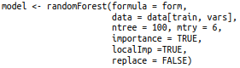
Pilot Model Creation
A very simple model trained on a subset of the source data:
Builds 100 decision trees by randomly sampling 6 variables at each node and using the best predictor of customer churn
Let’s see how it performs….

Slide 43
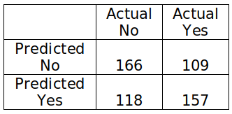
Results
Predictions
Overall accuracy: 59%
Most Important Variables
For predicting Yes:
Change in minutes
Equipment days
Off-peak calls
For predicting No:
Average monthly minutes
Recurring charge
In/out bound calls

Slide 44
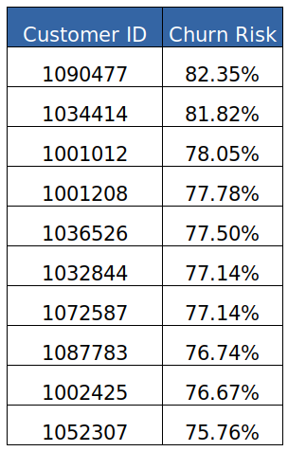
Full Implementation
Beyond the pilot project:
Improving predictive accuracy
- Up to 65-70%
- More complex model (logistic regression)
- Curated inputs
Testing the effectiveness of proactive
identification and outreach
- Contact 50 of the 100 most likely to churn customers
- Compare the number of cancellations between the
50 contacted and the 50 not contacted

Slide 45
Estimated Value
Assumptions:
Subscriber base = 50,000
Proportion likely to churn = 1 out of 10
Model accuracy = 70%
Proportion savable = 2 out of 7
Average monthly revenue = $58
Full implementation can save $58,000 of recurring monthly revenue

